Slide 1
Chapter 1
Basic Concepts
Review

Slide 2
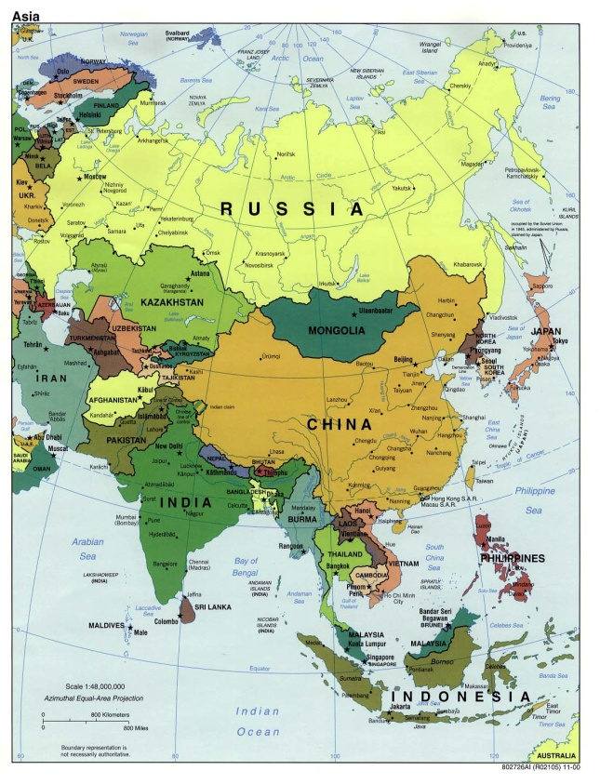
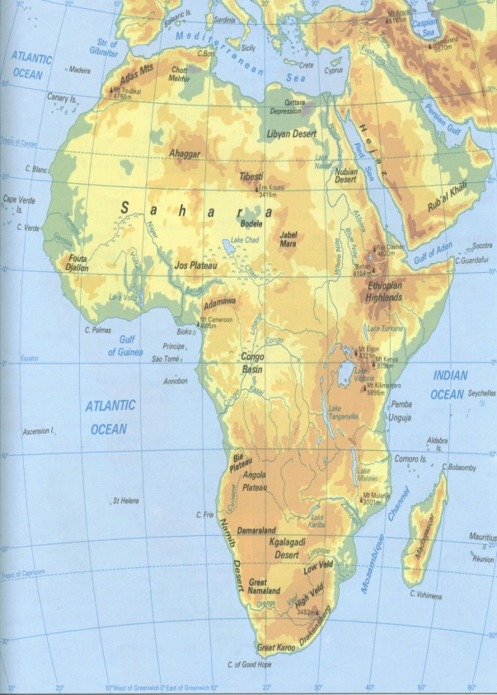
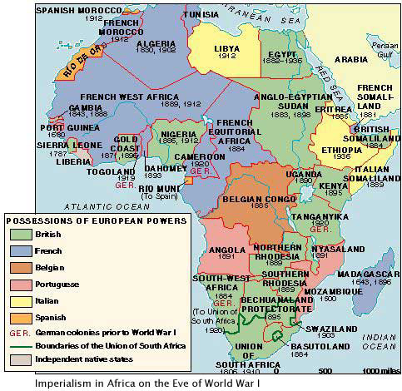
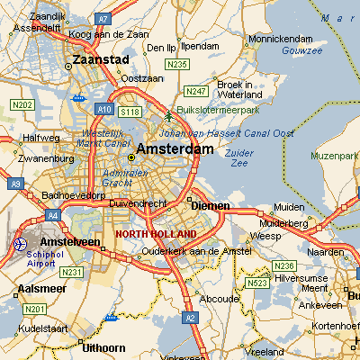
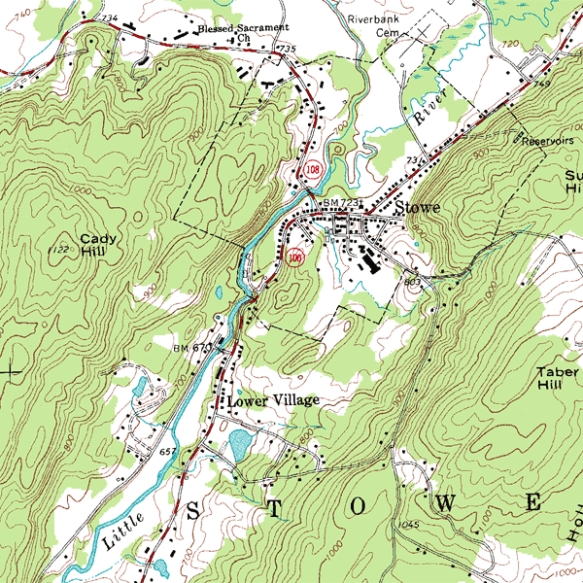
Reference Map
Political
Physical
Historical
Road
Topographic

Slide 3
Physical Maps
Use shaded or painted relief to illustrate the major landforms (natural features) of a region, country, or world.
Mountain ranges and rivers usually are prominent features on such maps; other features would include deserts, glaciers, lakes, and valleys.
The colors on physical maps often include brown or green for land and blue for water.

Slide 4
Political Maps
are reference maps that show names and boundaries of political geographic units (states, countries, etc.) and only very important physical or human features (e.g., rivers, highways, etc.)

Slide 5
Topographic Maps
Are general reference maps showing coastlines, cities, and rivers that use contour lines to show elevation differences. Such maps are helpful to hikers because they can show elevation changes along a trail
Government agencies like the U.S. Geological Survey (USGS) produce these maps that are often based on satellite data or aerial photography.

Slide 6
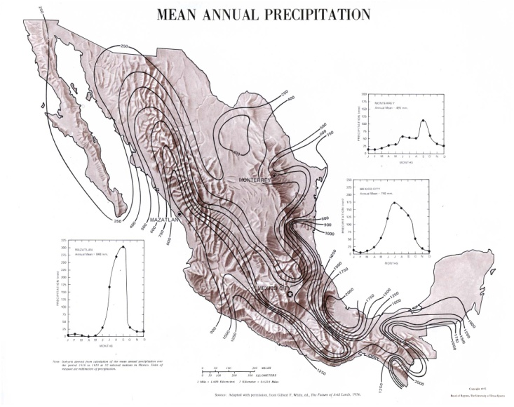
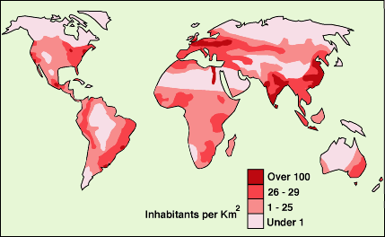
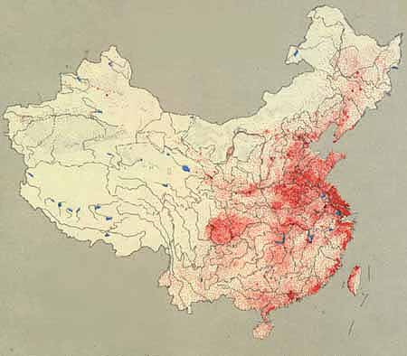
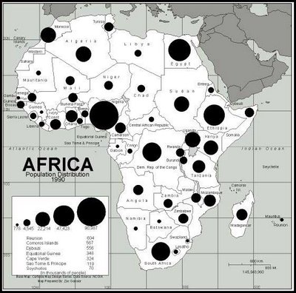
Thematic Maps
Isoline
Choropleth
Proportional symbol
Dot Density

Slide 7
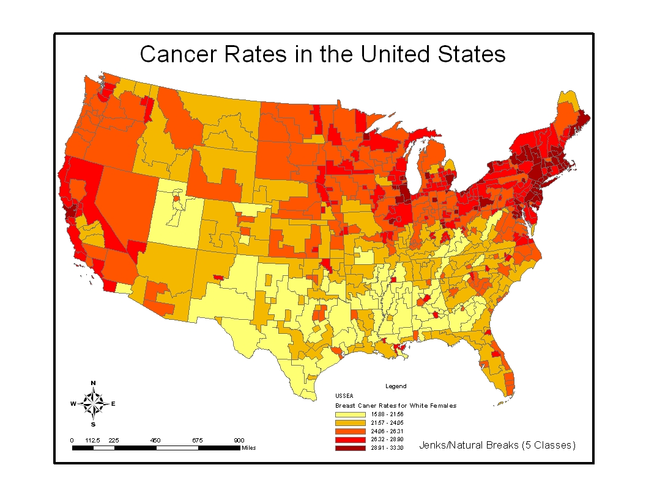
Choropleth Map

Slide 8
Choropleth Map
Use color shading to represent different quantities or values. Darker colors usually represent greater quantities or values, while lighter colors usually represent smaller quantities or values.

Slide 9
Dot Density Map

Slide 10
Dot Density Map
Uses points to show the precise locations of specific observations or occurrences
place individual points on a map to correspond with occurrences of a particular feature or data
Clusters of dots show where the features or data are concentrated

Slide 11
Proportional Symbol Map

Slide 12
Proportional Symbol Map
Use symbols of different sizes placed within an area to show the value or quantity associated with it.
The symbol is often a circle, but it may be one that relates to the map’s theme (such as figures of people to represent population data).

Slide 13
Isoline Map

Slide 14
Isoline Map
Connects points of equal or very similar values
Use lines to connect points of equal value, such as temperature, rainfall, or elevation.
Lines of equal temperature are called isotherms
Lines of equal rainfall are called isohyets
Lines of equal elevation are called contours
Contour lines are often used on topographic maps

Slide 15
Other Types of Maps
Cartogram
Cognitive or Mind/Mental Map

Slide 16
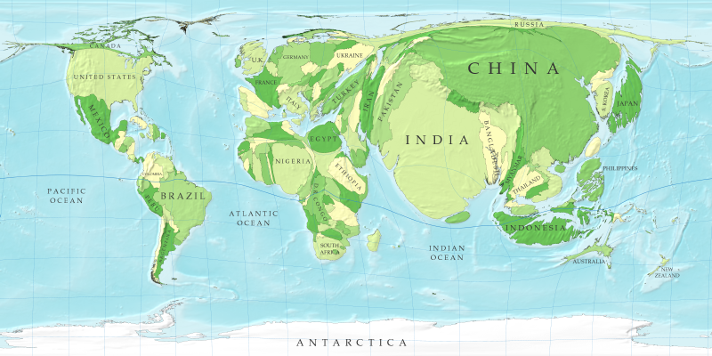
Cartogram

Slide 17
Cartogram
distort the size and shape of map areas to show statistical data.
For example, a cartogram of world population shows land area as proportional to population size—although the United States and China have similar land areas (the U.S. is slightly larger), a population cartogram would show China as much larger than the U.S. because its population is much larger.

Slide 18
Cognitive or Mind/Mental Map
allies

Slide 19
Cognitive or Mind/Mental Map
Everyone has one
It is a cognitive image of landscape in the human mind
Common about most people’s mental maps is that we have accurate geographies of area around our home, school, and workplace
Known landscape along transportation routes we use
Other places not in our mental map is blank
People can improve mental maps of places by using/reading maps

Slide 20
MAP PROJECTION & DISTORTION

Slide 21
Projection
Transferring locations from Earth’s surface to a flat map
Problem: distortion or alteration
Earth’s spherical shape and 3-D continents pose a challenge for cartographers because drawing Earth on a 2-D flat piece of paper produces some distortions.

Slide 22
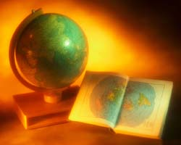
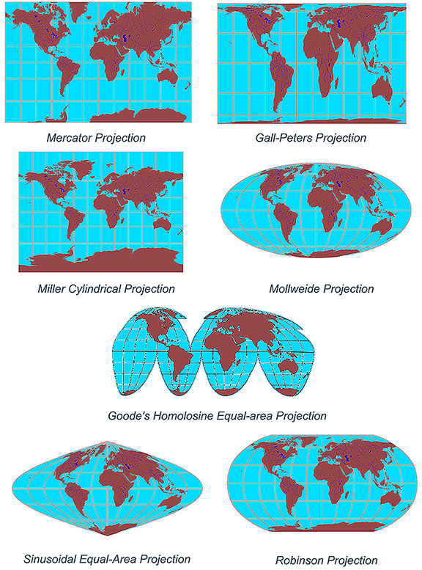
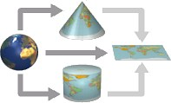
Projections
“All maps lie flat, and all flat maps lie”

Slide 23
Equal Area Projection
an equal-area map projection map showing parallels and the equator as straight lines and other meridians as curved; used to map tropical latitudes.
Type of: map projection. a projection of the globe onto a flat map using a grid of lines of latitude and longitude.

Slide 24
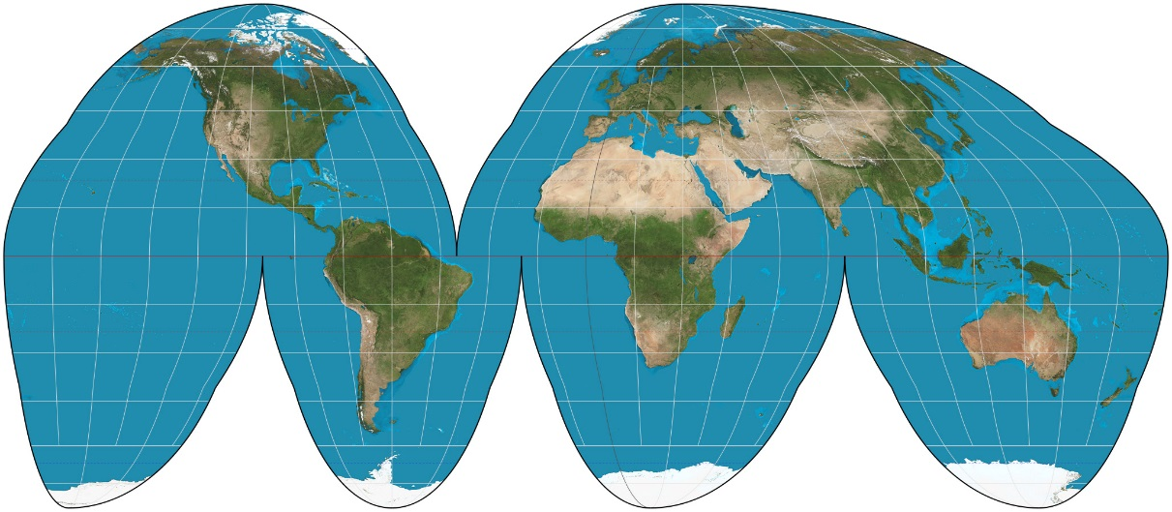
Equal Area Projection
Advantages: Shows true size and shape of land masses.
Disadvantages: Distorts (interrupts) shape of water areas

Slide 25
Peters Projection
Equal area
Advantages: Accurately represents the actual area of landforms.
Disadvantages: distorts other properties like shape

Slide 26
Robinson Projection
Compromise (neither equal or conformal)
Advantages: Better balance of size and shape of high-latitude lands than in Mercator or Mollweide. Directions true along all parallels and along central meridian.
Disadvantages: Distorts shape, area, scale, and distance in an attempt to balance the errors and so one property is not drastically distorted

Slide 27
Mercator Projection
Conformal
because it accurately represents the shape of landforms
Advantages: Used for marine navigation
Disadvantages: It is not equal in area because sizes of landforms are drastically distorted
Example: Greenland is larger on map than it should be

Slide 28
Azimuthal Projection
Flat-plan constructed maps of each hemisphere
Advantages: Directions from a central point are evident. Direction is accurate
Disadvantages: Distances from all other points are incorrect, and areas and shapes get distorted more that one moves away from the center of the projection.

Slide 29
PLACE

Slide 30
Place
A location on Earth distinguished by a particular characteristic
Occupies a unique location
Has things in common with other places
An area bounded by space of some human importance
Humans have a strong sense or feeling of it
A hometown, vacation destination, country

Slide 31
People don’t have to live there in order for a place to exist
Geographers describe features of it
To show similarities, differences, and changes across the globe
Identify its location or position on the Earth’s surface
Three ways to identify location:
place name
site
situation
Notes:
End Thursday, 8/26/16

Slide 32
1. Place name
What is its name and why
When human importance is recognized, it is common to assign a place name
Toponym: name for a place or location
Example- people that came from England, York, and Jersey in Europe came to US and named their new homes New England, New York, and New Jersey

Slide 33
2. Site
what it looks like
the physical characteristics of place
Example- New York City is located on a large, deep water harbor, next to the Atlantic Ocean

Slide 34
3. Situation
how its location and attributes are related to other places
a place’s interrelatedness with other places
Example- New York has the most prominent trade and finance center in US (1800s)
Uses Hudson River to transport goods to and from New England and is a major port along the Atlantic Circular Trade
Has much greater potential than Boston, Philadelphia and Charleston because of its large inland waterway

Slide 35
Change in Place
Attributes of place change overtime
Causes of change-
Sequent occupancy: the succession of groups and cultural influences throughout a place’s history
Several different historical layers contribute to place-specific culture, society, politics, and economy
For example-
Santa Fe, New Mexico
Has complex mix of multiple Native American, Spanish colonial, and modern American influences
based on the sequence of past and current societal influences

Slide 36
REGIONS

Slide 37
1. Formal Region
Is an area of space with a boundary that possesses some homogeneous characteristic or uniformity (similarity)
There is one thing that is the same within this region
Culture (common language)
Political (boundary lines)
Environment (ecotones; ex. the space between the Sahara Desert and the tropical savanna is a dry grassland known as the Sahel)

Slide 38
2. Functional or Nodal Region
Areas that have a central place or node that is the focus or point of origin
Also known as “nodal region”
Strongest influence of central place for those who live closest to it
Distance decay is experienced by those further away from the central place
The influence of this point is strongest in the areas close to the center
Example-
Example: market area for a sports team will have the strongest fan base and intensive medial network coverage in areas close to the team’s home city

Slide 39
3. Perceptual Region
Also known as a vernacular region
is made up by the residents of the places; is based on the things these residents feel define it as a particular region
Example-
Some people in the American South believe that what defines their region is the country music bands, numbers of Southern Baptist Churches, and NASCAR races
Southern Californians may define their region as having sunny weather, surfing, Mexican food, rap and rock music, laid back (“dude”) and health-oriented citizens
Notes:
End 3rd period 8/28/17, start here.
End 6th period 8/28/17, start here.

Slide 40
Regionalization
area with one or more unique characteristics
a type of place Ex: Bible Belt, Sun Belt, etc.

Slide 41
SPACE

Slide 42
Space
Is a geometric surface or area on the earth
When geographers analyze or think about space it is called “spatial analysis” or “thinking spatially”
When thinking about space (“thinking spatially”)
Geographers look objects in a space
Objects could be trees, people, buildings, and even whole cities
They observe how these objects are distributed or spread out and see if there is a pattern
They analyze any relationships, connections, movement, growth and change in the objects or in the space overtime
Notes:
– Tuesday

Slide 43
Distribution
How objects or people are distributed or spread out in a space or location
Three properties of distribution in space:
Density
Concentration
Pattern

Slide 44
1. Density
The frequency (rate) that something exists in a space
People, houses, cars, or trees are items that are measured

Slide 46
Types of Density
Arithmetic (population) density: is calculated by number of things per square unit of distance
Physiologic density: measures the number of people per square unit of arable land
Land that has been farmed and land that has the potential to be farmed
So, how many ppl have to be fed with how much land is open for farming.
Agricultural density: refers to the number of people needed to farm per square unit of land
Land is actively used for farming
Notes:
We will talk about population density the most. China has a lot of people BUT per square mile, there are less people, lots of land. Netherlands, less people, and less land = higher population density.

Slide 47
2. Concentration
The spread of something over a space or location
If it is close, it is called clustered.
If it is spread out, it is called dispersed.
It helps describe changes in distribution.

Slide 48
Clustered or Dispersed

Slide 49
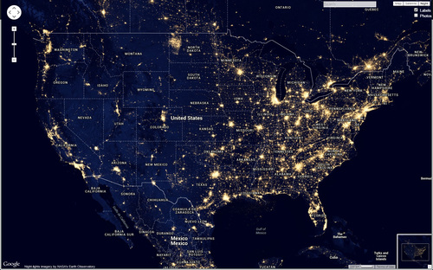
Clustered or Dispersed

Slide 50
3. Pattern
Geometric arrangement of objects in a space
Objects are usually arranged in square or rectangular patterns
Patterns of streets
On a grid

Slide 51
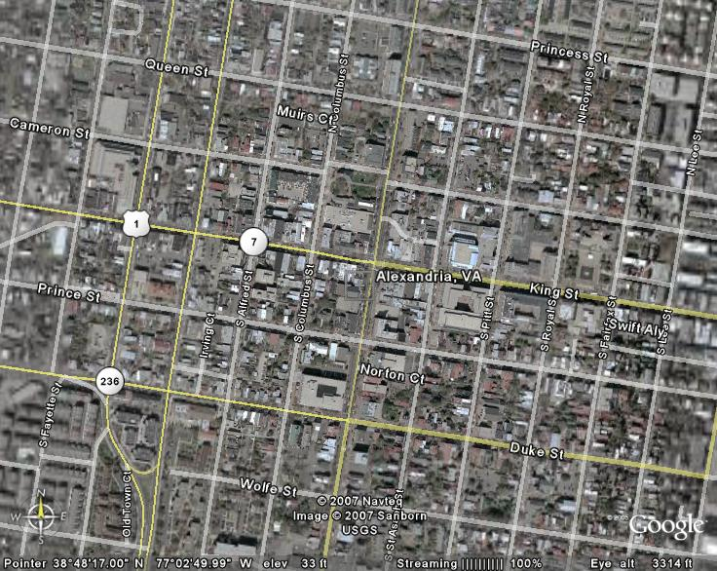

Slide 52
DIFFUSION

Slide 53
Spatial Diffusion
Diffusion: is the process by which characteristics spread from one place to another overtime
There are a number of ways and patterns that human phenomena diffuse or spread spatially or spread across Earth’s surface
Hearth: place where innovation originates
hearth orginiates when a cultural group is willing to try something new
This cultural group seeks out interaction with other persons, objects, and ideas in other regions
They diffuse

Slide 54
Expansion Diffusion and Types
Expansion diffusion: a pattern that starts in a central place and then expands outward in all directions to other locations
Three types of expansion diffusion:
Hierarchical diffusion: spread of idea from persons of authority (political leaders)
Moves from first-order location down to subordinate second-order location
For example- fashion trends, go from one urban center to another.
Contagious diffusion: diffusion of characteristic throughout population
Starts at point of origin then moves to nearby locations
For example- spread of disease or news

Slide 55
Stimulus Diffusion: an idea or principle diffuses which stimulates the creation of new products or ideas
For example- when vegetarian eating habits (principle) influence restaurants to offer more vegetarian dishes

Slide 56
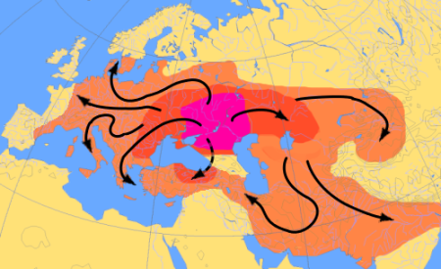

Slide 58
Relocation Diffusion
Ideas and items spread from point of origin and then crosses a significant physical barrier
Barrier can be ocean, mountain range, or desert
They can spread language, technology, religion, disease and culture
For example: Explorers venture to America bringing new language, religion, disease and culture with them.

